Slide 1
EE746 Neuromorphic Engineering Lecture 2d: Noisy Neuron Model
Udayan Ganguly
udayan@ee.iitb.ac.in
Feb, 11, 2020
Lectures follow Chapter 3: Neuron Models in Neural Computation by MATLAB book;
You can also read http://icwww.epfl.ch/~gerstner/SPNM/node32.html for basis in biology;
Please read;

Slide 2
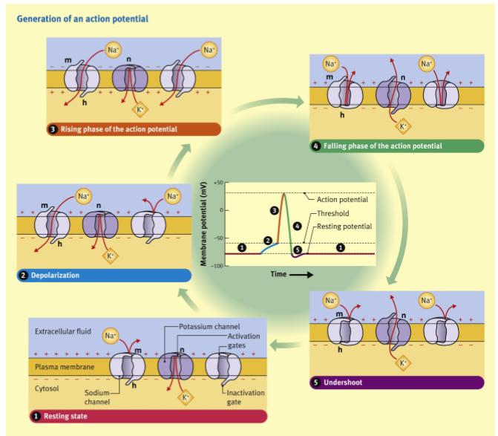
Next Step
Develop Mathematical model for Spiking Neuron

Slide 3
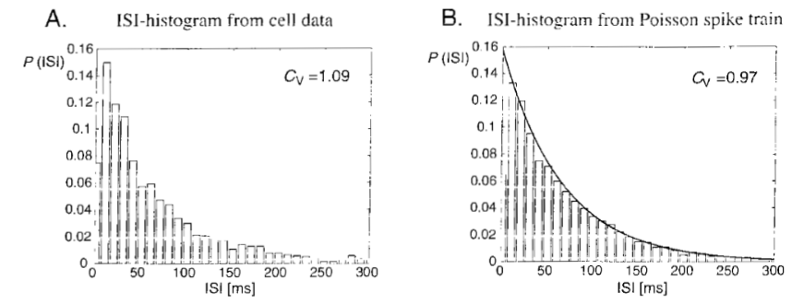
Inter-Spike Interval (ISI)

Slide 4
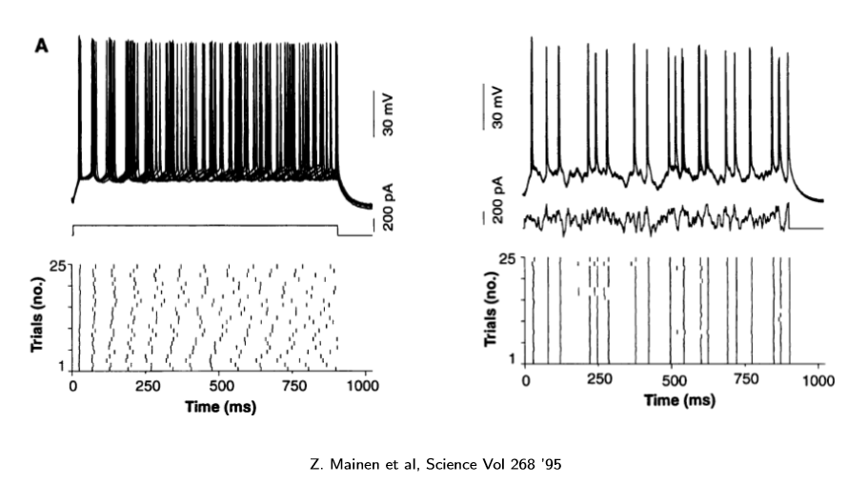
Neuronal response to input
Repeated input of same “dc signal”
Repeated input of same “random signal”

Slide 5
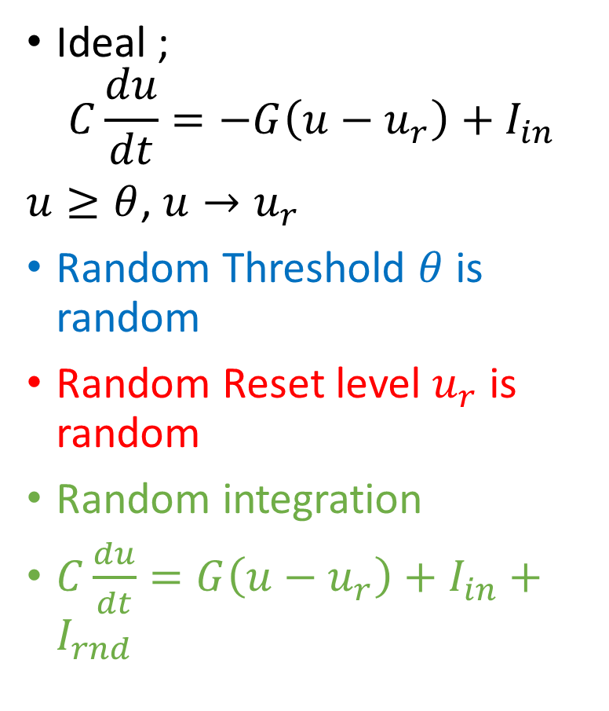
Three sources of Noise in LIF
Ideal ;
$$C\frac{du}{dt}=−G\left(u−u_{r}\right)+I_{in}$$
$u≥θ$, $u→u_{r}$
Random Threshold $θ$ is random
Random Reset level $u_{r}$ is random
Random integration
$C\frac{du}{dt}=G\left(u−u_{r}\right)+I_{in}+I_{rnd}$

Slide 6
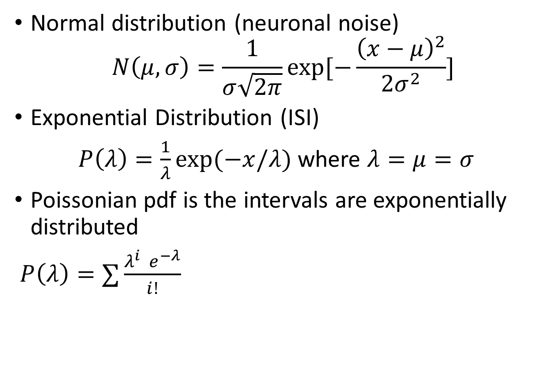
Noise & Randomness
Normal distribution (neuronal noise)
$$N\left(μ,σ\right)=\frac{1}{σ\sqrt{2π}}\exp{[−\frac{{\left(x−μ\right)}^{2}}{2σ^{2}}]}$$
Exponential Distribution (ISI)
$P\left(λ\right)=\frac{1}{λ}\exp{(−x/λ)}$ where $λ=μ=σ$
Poissonian pdf is the intervals are exponentially distributed
$P\left(λ\right)=∑\frac{λ^{i} e^{−λ}}{i!}$

Slide 7
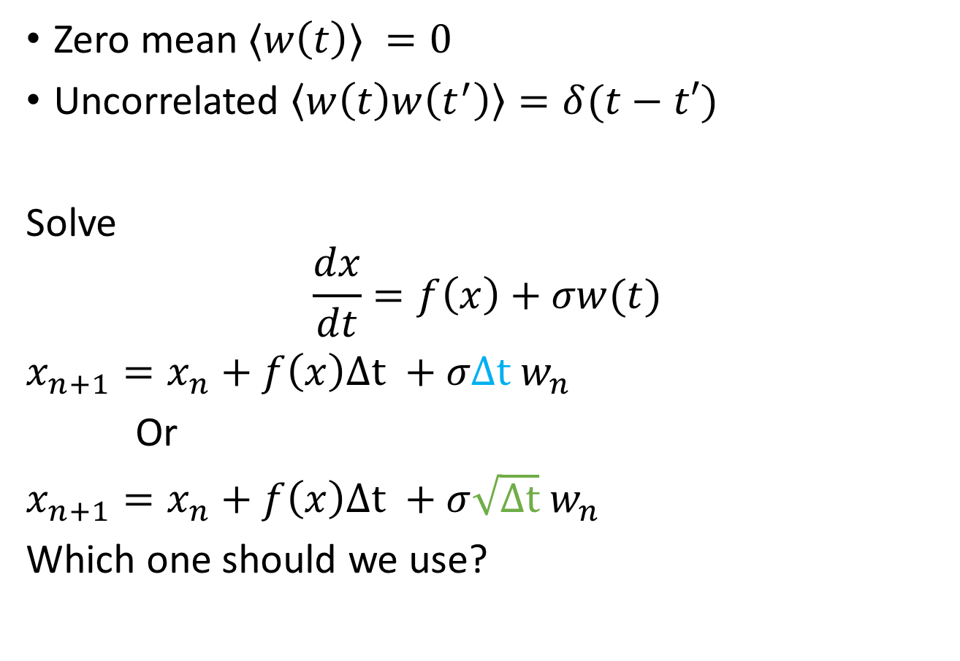
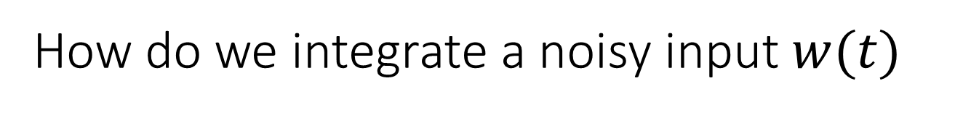
How do we integrate a noisy input $w(t)$
Zero mean $⟨w\left(t\right)⟩ =0$
Uncorrelated $\left\langle w\left(t\right)w\left(t^{′}\right)\right\rangle =δ(t−t′)$
Solve
$$\frac{dx}{dt}=f\left(x\right)+σw(t)$$
$x_{n+1}=x_{n}+f\left(x\right)Δt +σΔt w_{n}$
Or
$x_{n+1}=x_{n}+f\left(x\right)Δt +σ\sqrt{Δt} w_{n}$
Which one should we use?

Slide 8
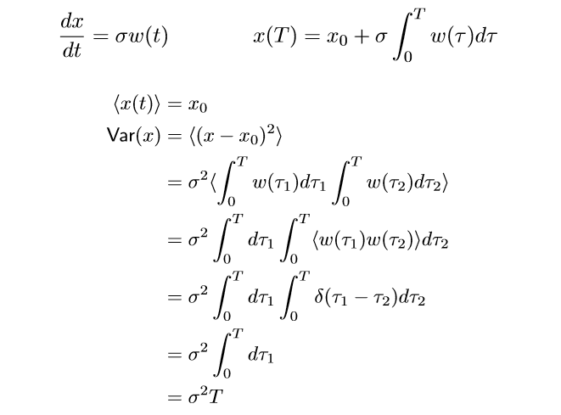

Mean and Sigma
pdf
x
Visualize why this is true..
When deterministic function is rate then simple trajectory
When stochastic function is rate, then random walk trajectory
Variance scales linearly with T
$$x_{n+1}=x_{n}+f\left(x\right)Δt +σ\sqrt{Δt} w_{n}$$

Slide 9
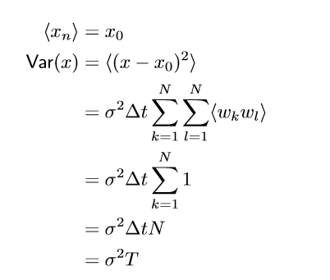
Discrete case

